Slide 1
Chapter 2: Operating-System Structures

Slide 2
Chapter 2: Operating-System Structures
Operating System Services
User Operating System Interface
System Calls
Types of System Calls
System Programs
Operating System Structure

Slide 3
Objectives
To describe the services an operating system provides to users, processes, and other systems
To discuss the various ways of structuring an operating system

Slide 4
Operating System Services
One set of operating-system services provides functions that are helpful to the user:
  User interface - Command-Line (CLI), Graphics User Interface (GUI), Batch
  Program execution - system must load a program into memory, run that program, and end execution, either normally or abnormally (indicating error)
  I/O operations - A running program may require I/O, which may involve a file or an I/O device
  File-system manipulation - read and write files and directories, create and delete them, search them, list file Information, permission management.

Slide 5
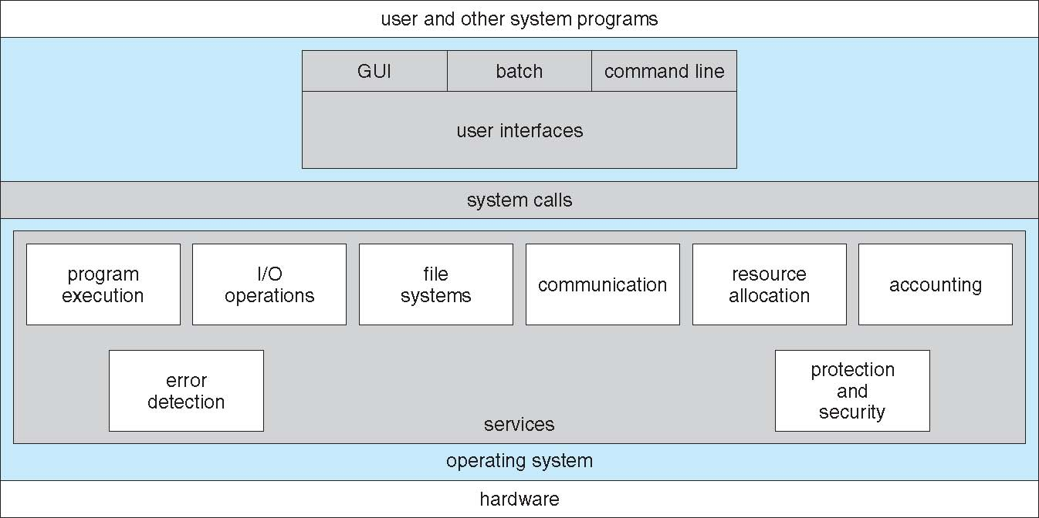
A View of Operating System Services

Slide 6
Operating System Services (Cont)
One set of operating-system services provides functions that are helpful to the user (Cont):
  Communications – Processes may exchange information, on the same computer or between computers over a network
    Communications may be via shared memory or through message passing (packets moved by the OS)
  Error detection – OS needs to be constantly aware of possible errors
    May occur in the CPU and memory hardware, in I/O devices, in user program
    For each type of error, OS should take the appropriate action to ensure correct and consistent computing
    Debugging facilities can greatly enhance the user’s and programmer’s abilities to efficiently use the system

Slide 7
Operating System Services (Cont)
Another set of OS functions exists for ensuring the efficient operation of the system itself via resource sharing
  Resource allocation - When multiple users or multiple jobs running concurrently, resources (such as CPU cycles, main memory, file storage, I/O devices) must be allocated to each of them
  Accounting - To keep track of which users use how much and what kinds of computer resources
  Protection and security - owners of information stored in a multiuser or networked computer system may want to control use of that information, concurrent processes should not interfere with each other

Slide 8
User Operating System Interface - CLI
Command Line Interface (CLI) or command interpreter allows direct command entry
    Can be implemented in kernel, sometimes by systems program
    Sometimes implemented using shells
    Fetches a command from user and executes it
      Some commands built-in, sometimes just names of programs which facilitates adding new commands

Slide 9
User Operating System Interface - GUI
User-friendly desktop metaphor interface
  Usually mouse, keyboard, and monitor
  Icons represent files, programs, actions, etc
  Various mouse buttons over objects in the interface cause various actions (provide information, options, execute function, open directory (known as a folder)
  Invented at Xerox PARC

Slide 10
User Operating System Interface - GUI
Many systems now include both CLI and GUI interfaces
  Microsoft Windows is GUI with CLI “command” shell
  Apple Mac OS X as “Aqua” GUI interface with UNIX kernel underneath and shells available
  Solaris is CLI with optional GUI interfaces (Java Desktop, KDE)

Slide 11
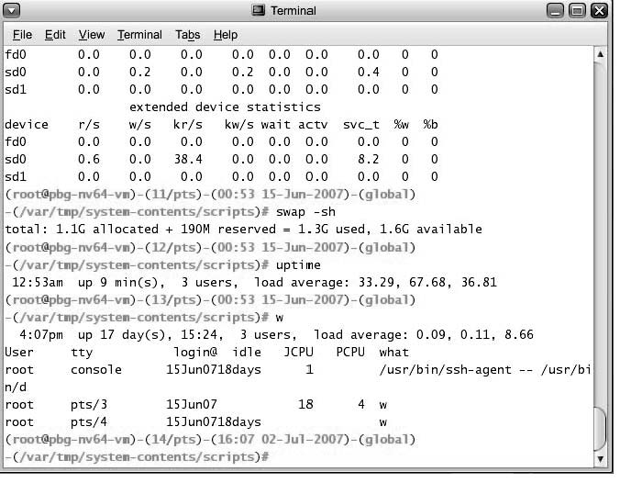
Bourne Shell Command Interpreter

Slide 12
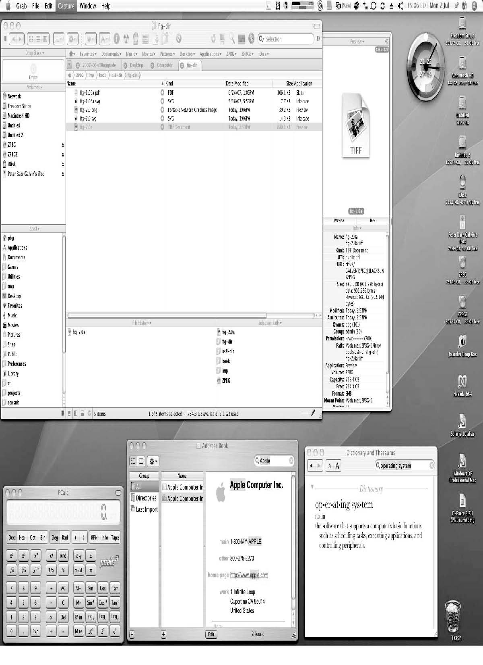
The Mac OS X GUI

Slide 13
System Calls
Programming interface to services provided by the OS
Typically written in a high-level language (C or C++)
Mostly accessed by programs via a high-level Application Program Interface (API) rather than direct system call use
Three most common APIs are Win32 API for Windows, POSIX API for POSIX-based systems (including virtually all versions of UNIX, Linux, and Mac OS X), and Java API for the Java virtual machine (JVM)
Why use APIs rather than system calls?

Slide 14
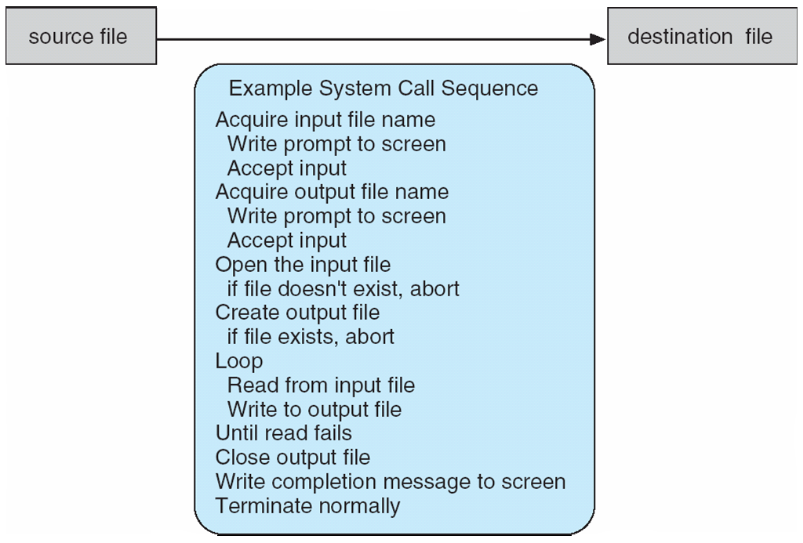
Example of System Calls
System call sequence to copy the contents of one file to another file

Slide 15
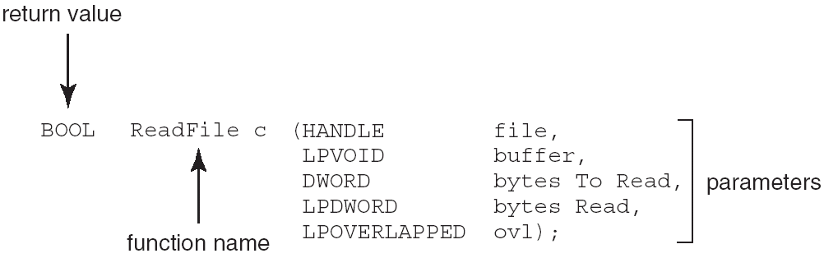
Example of Standard API
Consider the ReadFile() function in the
Win32 API—a function for reading from a file
A description of the parameters passed to ReadFile()
  HANDLE file—the file to be read
  LPVOID buffer—a buffer where the data will be read into and written from
  DWORD bytesToRead— # of bytes to be read into the buffer
  LPDWORD bytesRead— # of bytes read during the last read
  LPOVERLAPPED ovl—indicates if overlapped I/O is being used

Slide 16
System Call Implementation
Typically, a number associated with each system call
  System-call interface maintains a table indexed according to these numbers
The system call interface invokes intended system call in OS kernel and returns status of the system call and any return values
The caller need know nothing about how the system call is implemented
  Just needs to obey API and understand what OS will do as a result call
  Most details of OS interface hidden from programmer by API
    Managed by run-time support library (set of functions built into libraries included with compiler)

Slide 17
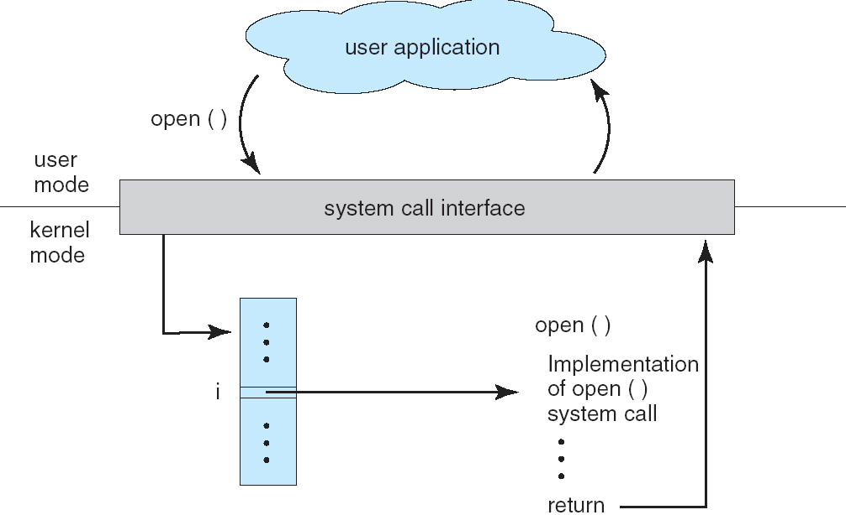
API – System Call – OS Relationship

Slide 18
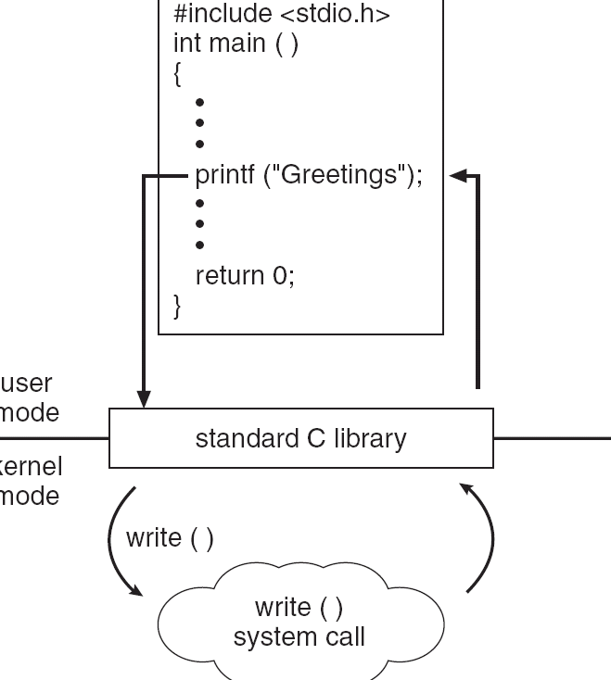
Standard C Library Example
C program invoking printf() library call, which calls write() system call

Slide 19
System Call Parameter Passing
Often, more information is required than simply identity of desired system call
  Exact type and amount of information vary according to OS and call
Three general methods used to pass parameters to the OS
  Simplest: pass the parameters in registers
    In some cases, may be more parameters than registers
  Parameters stored in a block, or table, in memory, and address of block passed as a parameter in a register
    This approach taken by Linux and Solaris
  Parameters placed, or pushed, onto the stack by the program and popped off the stack by the operating system
  Block and stack methods do not limit the number or length of parameters being passed

Slide 20
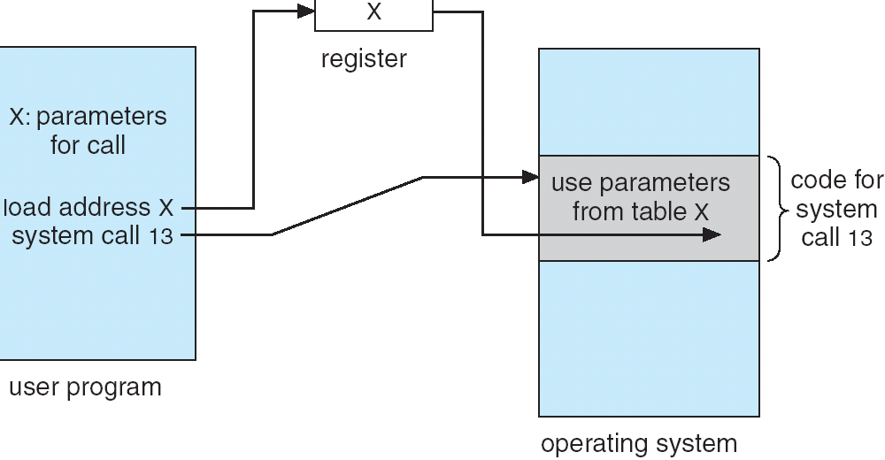
Parameter Passing via Table

Slide 21
Types of System Calls
Process control
File management
Device management
Information maintenance
Communications
Protection

Slide 22
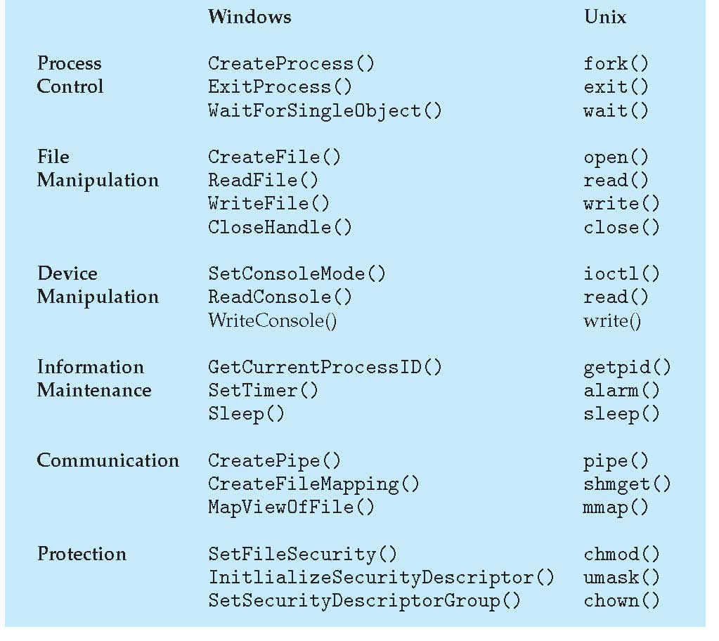
Examples of Windows and Unix System Calls

Slide 23
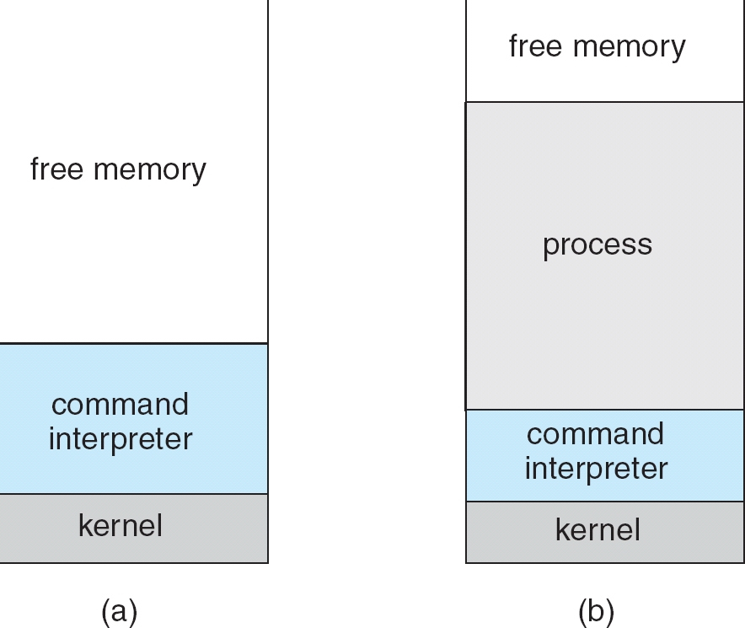
MS-DOS execution
(a) At system startup (b) running a program

Slide 24
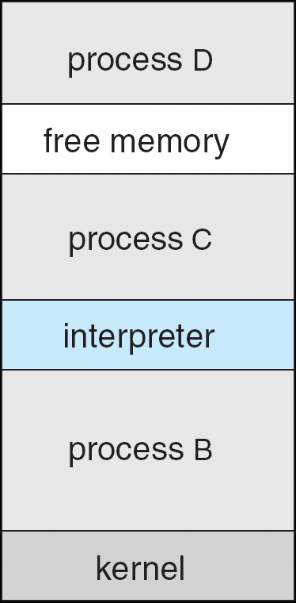
FreeBSD Running Multiple Programs

Slide 25
System Programs: Categories
System programs provide a environment for program development and execution. They can be divided into several categories:
  File manipulation
  Status information
  File modification
  Programming language support
  Program loading and execution
  Communications
  Application programs
Most users’ view of the operation system is defined by system programs, not the actual system calls

Slide 26
System Programs
Provide a convenient environment for program development and execution
  Some of them are simply user interfaces to system calls; others are considerably more complex
File management - Create, delete, copy, rename, print, dump, list, and generally manipulate files and directories
Status information
  Some ask the system for info - date, time, amount of available memory, disk space, number of users
  Others provide detailed performance, logging, and debugging information
  Typically, these programs format and print the output to the terminal or other output devices
  Some systems implement a registry - used to store and retrieve configuration information

Slide 27
System Programs (cont’d)
File modification
  Text editors to create and modify files
  Special commands to search contents of files or perform transformations of the text
Programming-language support - Compilers, assemblers, debuggers and interpreters sometimes provided
Program loading and execution- Absolute loaders, relocatable loaders, linkage editors, and overlay-loaders, debugging systems for higher-level and machine language
Communications – Provide mechanism for creating virtual connections among processes, users, & computer systems
  Allow users to send messages to one another’s screens, browse web pages, send electronic-mail messages, log in remotely, transfer files from one machine to another

Slide 28
Simple Structure
MS-DOS – written to provide the most functionality in the least space
  Not divided into modules
  Although MS-DOS has some structure, its interfaces and levels of functionality are not well separated

Slide 29
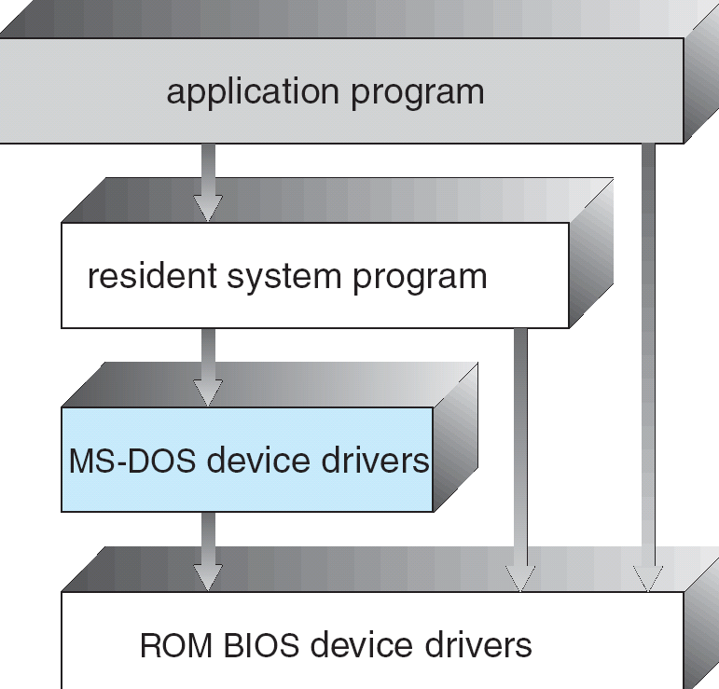
MS-DOS Layer Structure

Slide 30
Layered Approach
The operating system is divided into a number of layers (levels), each built on top of lower layers. The bottom layer (layer 0), is the hardware; the highest (layer N) is the user interface.
With modularity, layers are selected such that each uses functions (operations) and services of only lower-level layers

Slide 31
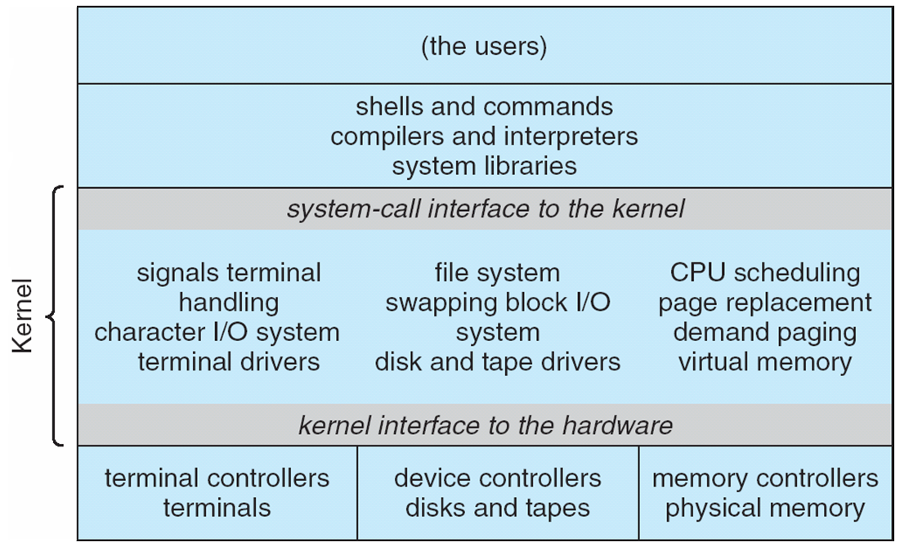
Traditional UNIX System Structure

Slide 32
UNIX
UNIX – limited by hardware functionality, the original UNIX operating system had limited structuring. The UNIX OS consists of two separable parts
  Systems programs
  The kernel
    Consists of everything below the system-call interface and above the physical hardware
    Provides the file system, CPU scheduling, memory management, and other operating-system functions; a large number of functions for one level

Slide 33
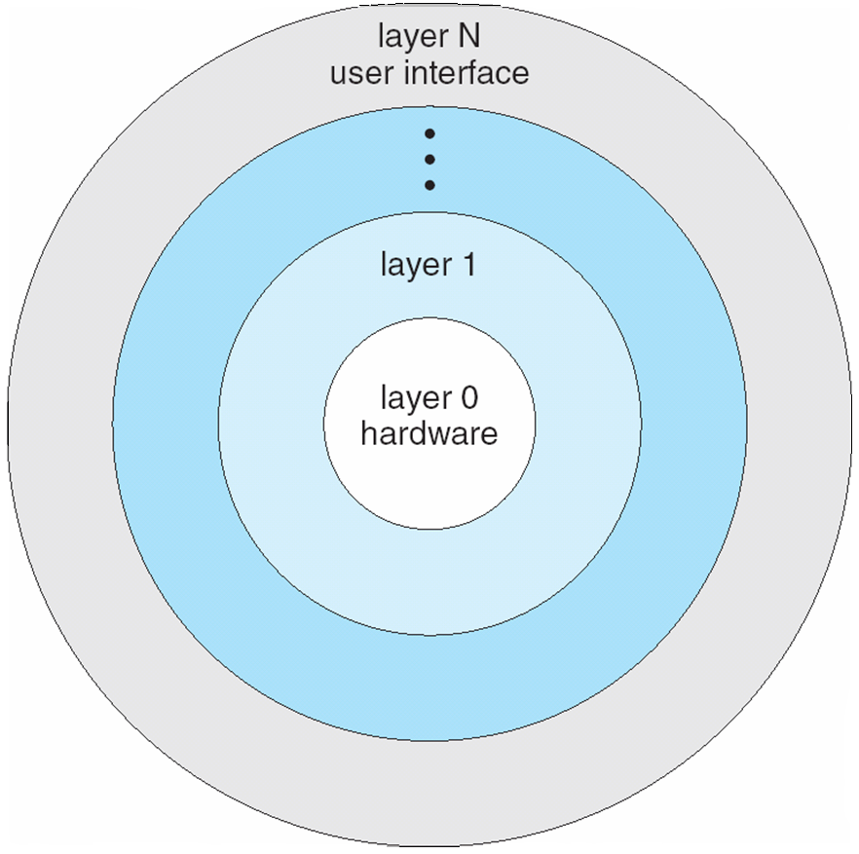
Layered Operating System

Slide 34
Microkernel System Structure
Moves as much from the kernel into “user” space
Communication takes place between user modules using message passing
Benefits:
  Easier to extend a microkernel
  Easier to port the operating system to new architectures
  More reliable (less code is running in kernel mode)
  More secure
Detriments:
  Performance overhead of user space to kernel space communication

Slide 35
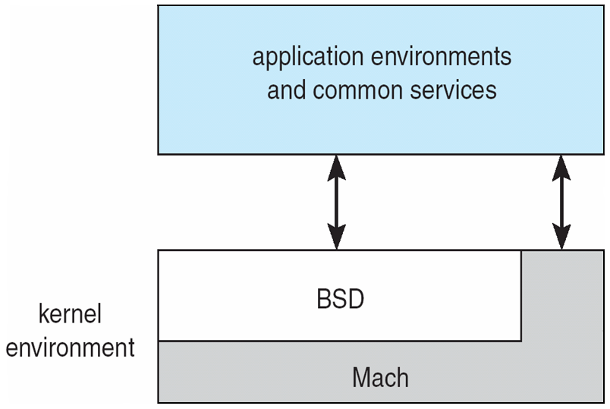
Mac OS X Structure

Slide 36
Modules
Most modern operating systems implement kernel modules
  Uses object-oriented approach
  Each core component is separate
  Each talks to the others over known interfaces
  Each is loadable as needed within the kernel
Overall, similar to layers but with more flexible

Slide 37
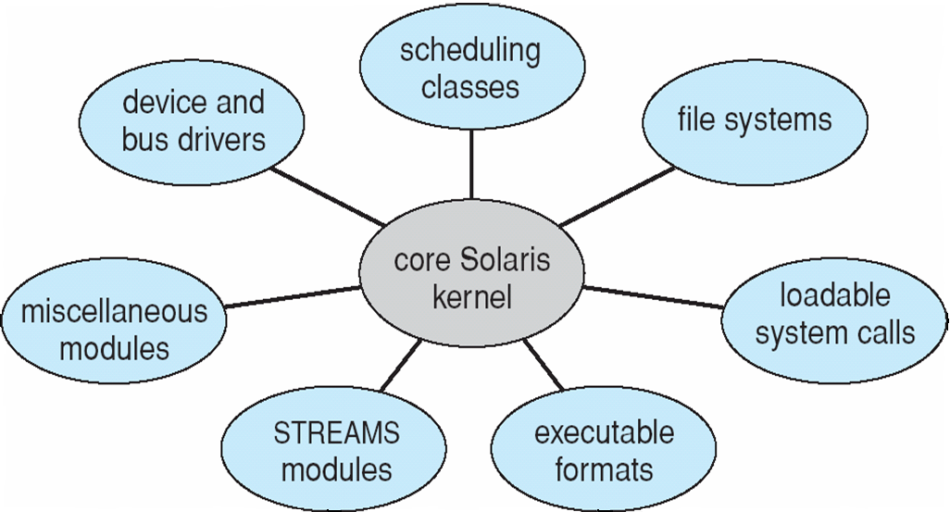
Solaris Modular Approach

Slide 38
System Boot
Operating system must be made available to hardware so hardware can start it
  Small piece of code – bootstrap loader, locates the kernel, loads it into memory, and starts it
  Sometimes two-step process where boot block at fixed location loads bootstrap loader
  When power initialized on system, execution starts at a fixed memory location
    Firmware used to hold initial boot code

Slide 39
End of Chapter 2

