Slide 1
A World of Art
Henry M. Sayre

Slide 2
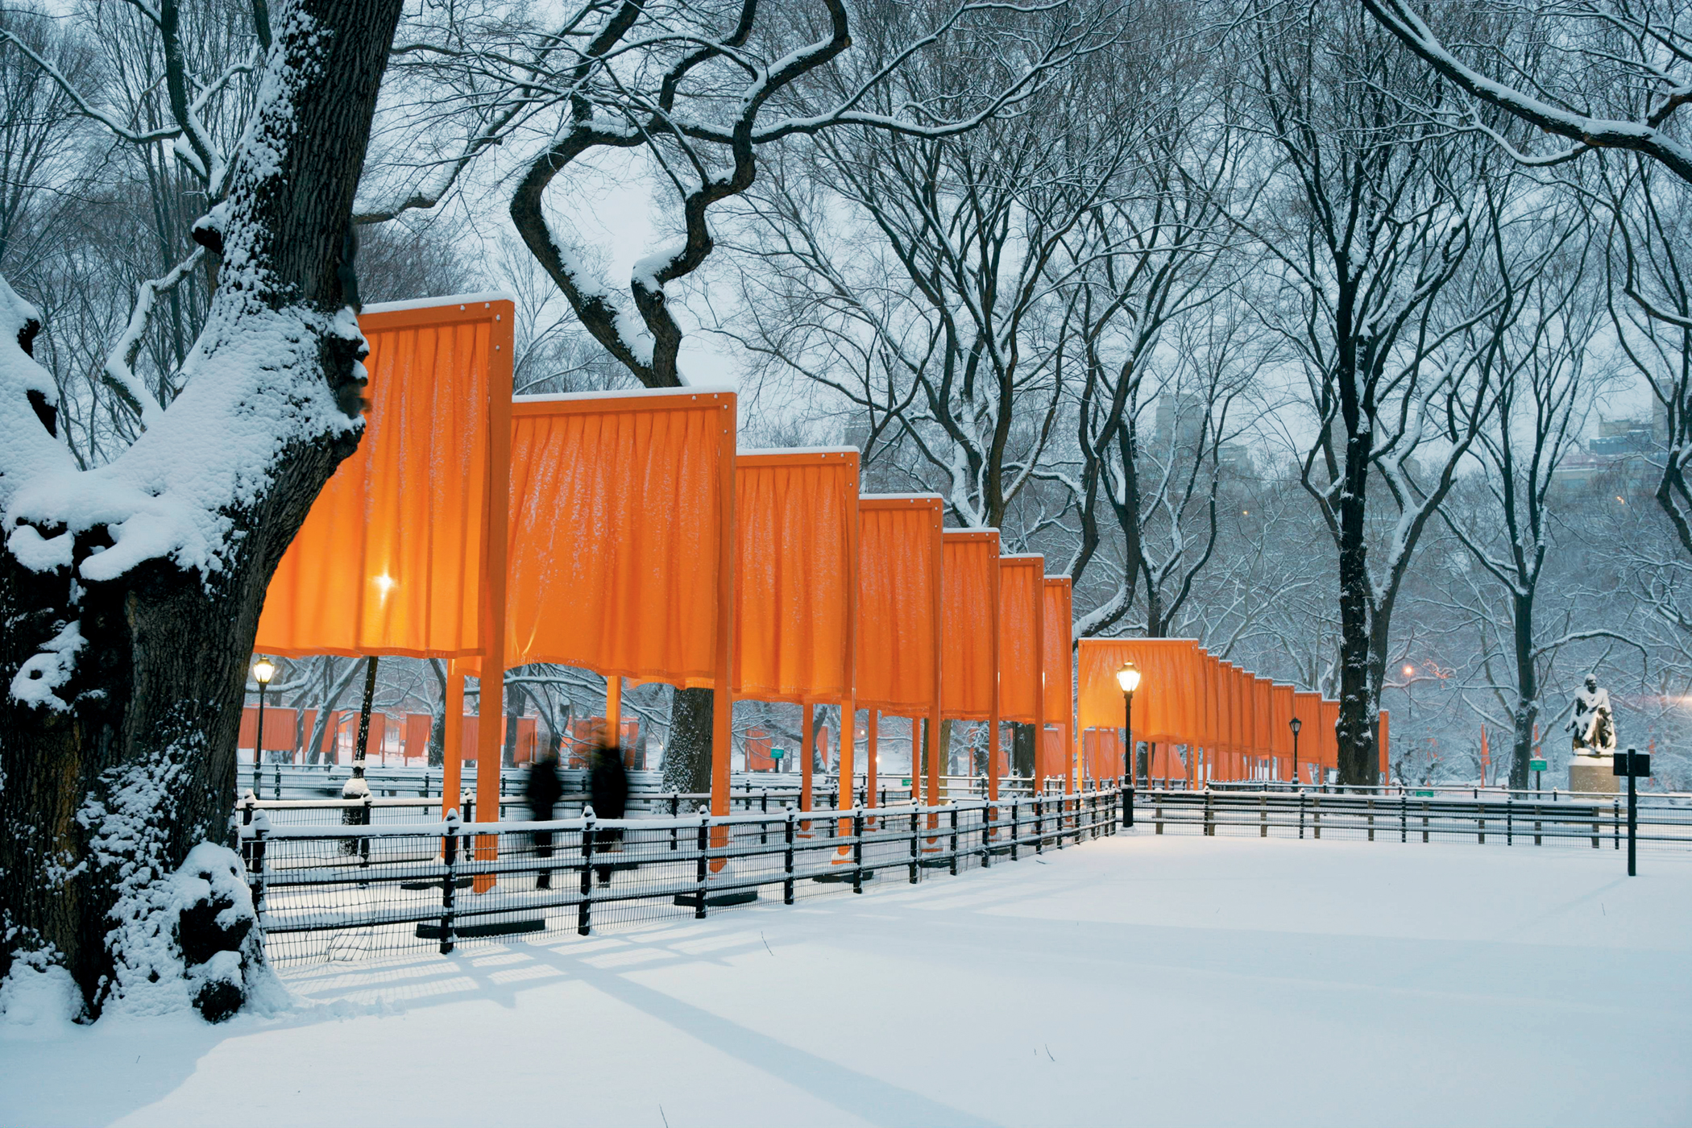

Slide 3
Title:
Artist:
Medium:
Date:

Slide 4
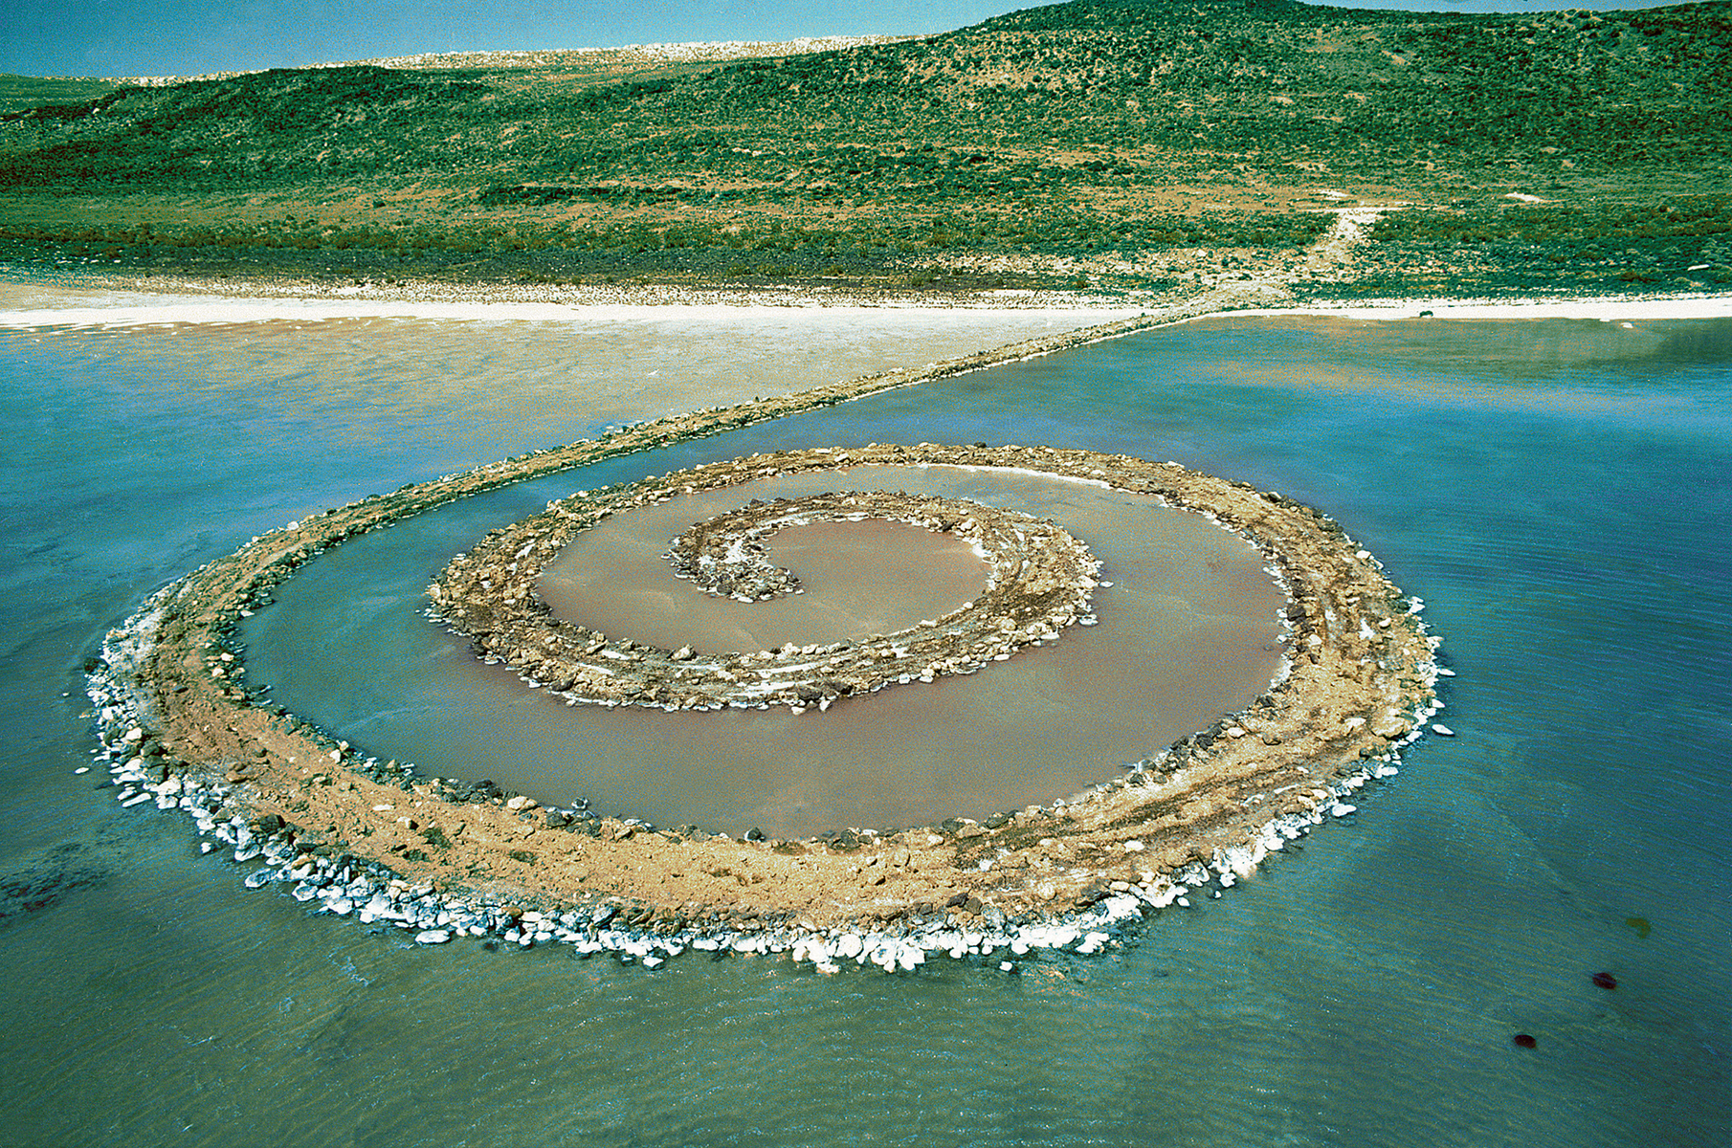

Slide 5
Title:
Artist:
Medium:
Date:

Slide 6
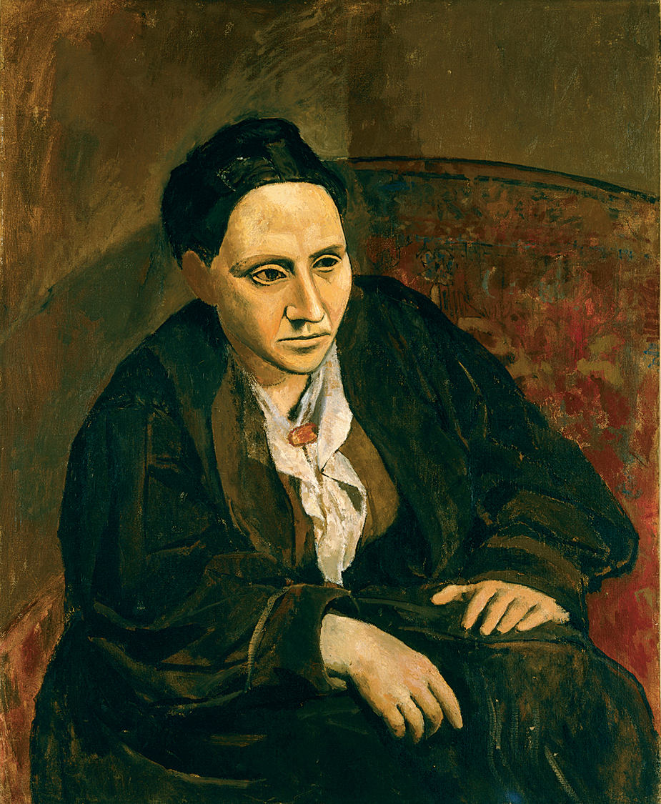

Slide 7
Title:
Artist:
Medium:
Date:

Slide 8
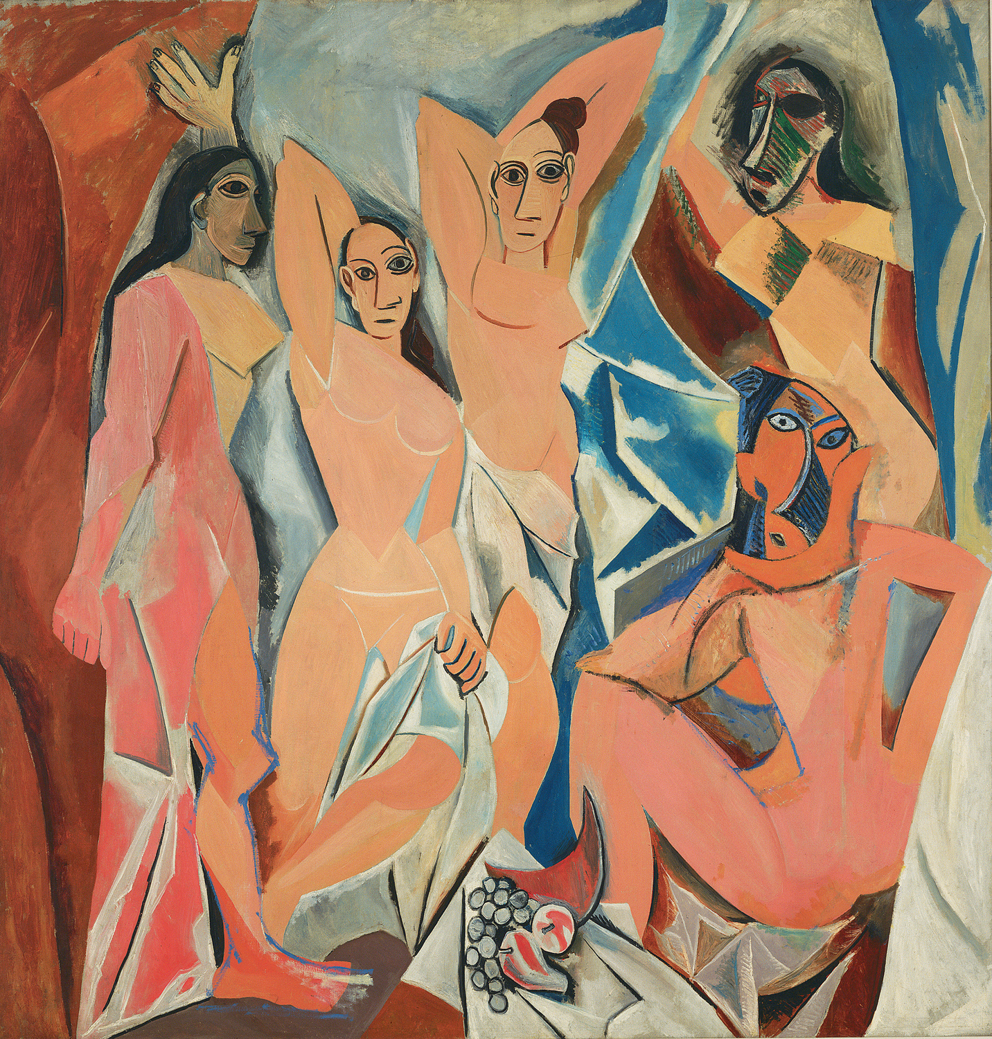

Slide 9
Title:
Artist:
Medium:
Date:

Slide 10
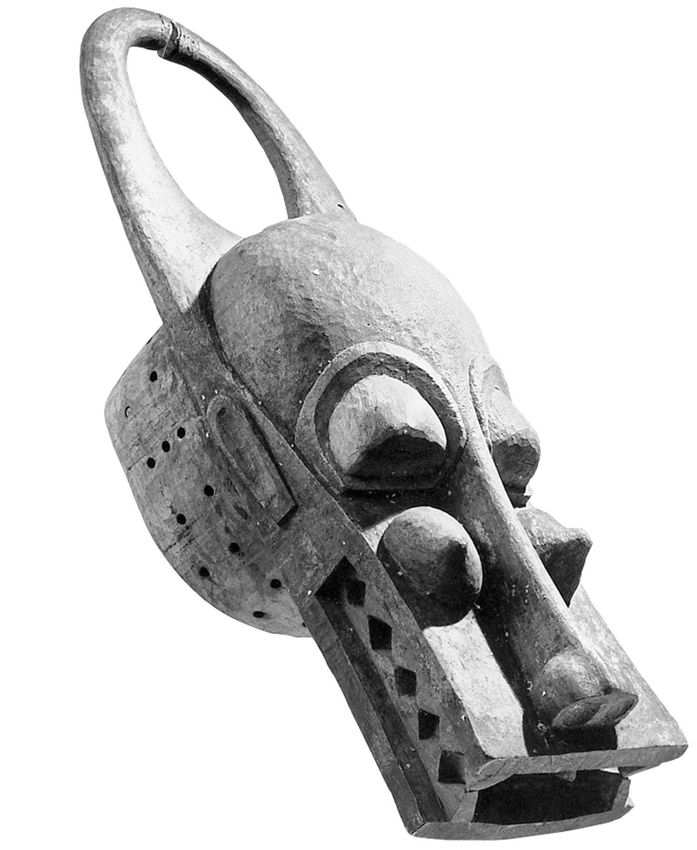

Slide 11
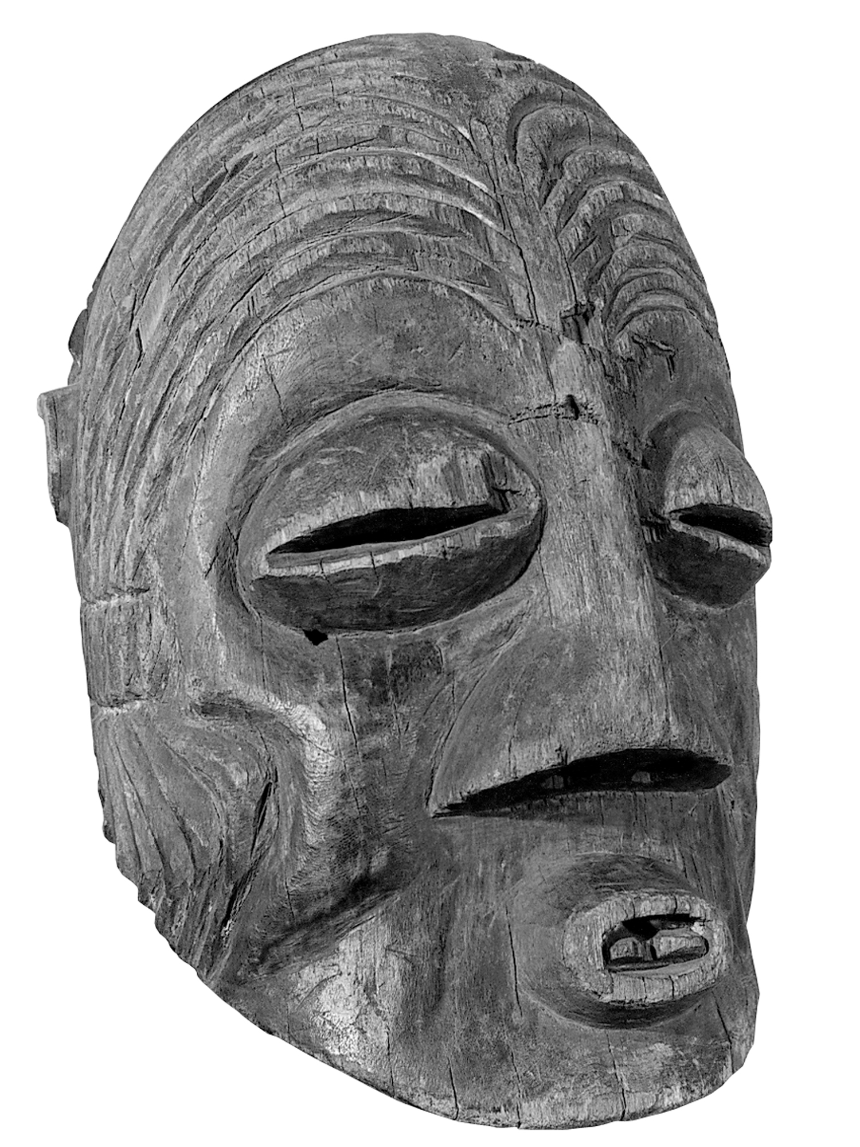

Slide 12
These masks from __________________,
shown in Paris in the early 20th century,
exerted a powerful influence on _____________

Slide 13
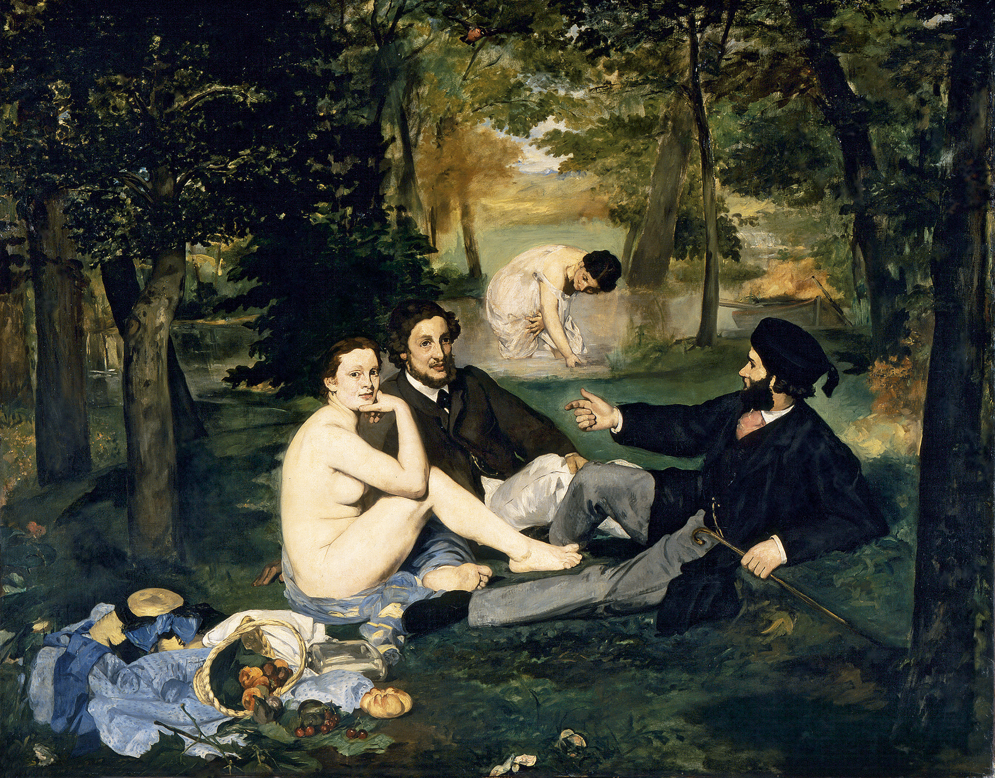

Slide 14
Title:
Artist:
Medium:
Date:

Slide 15
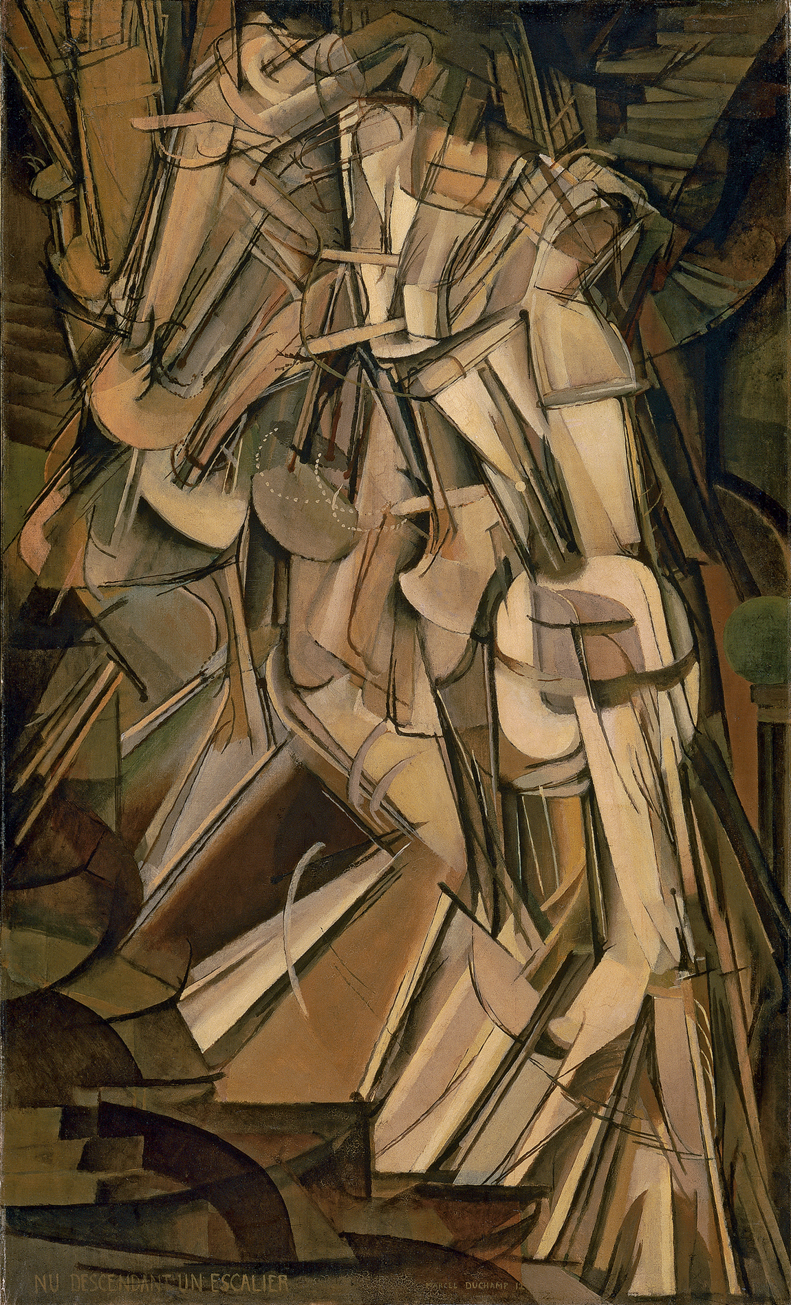

Slide 16
Title:
Artist:
Medium:
Date:

Slide 17
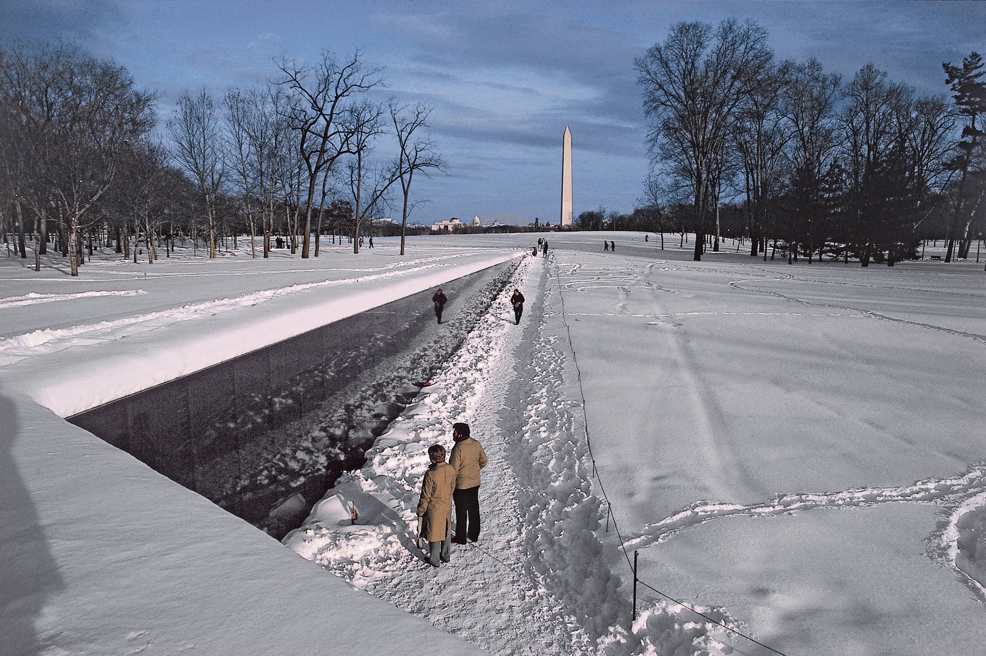

Slide 18
Title:
Artist:
Medium:
Date:

Slide 19
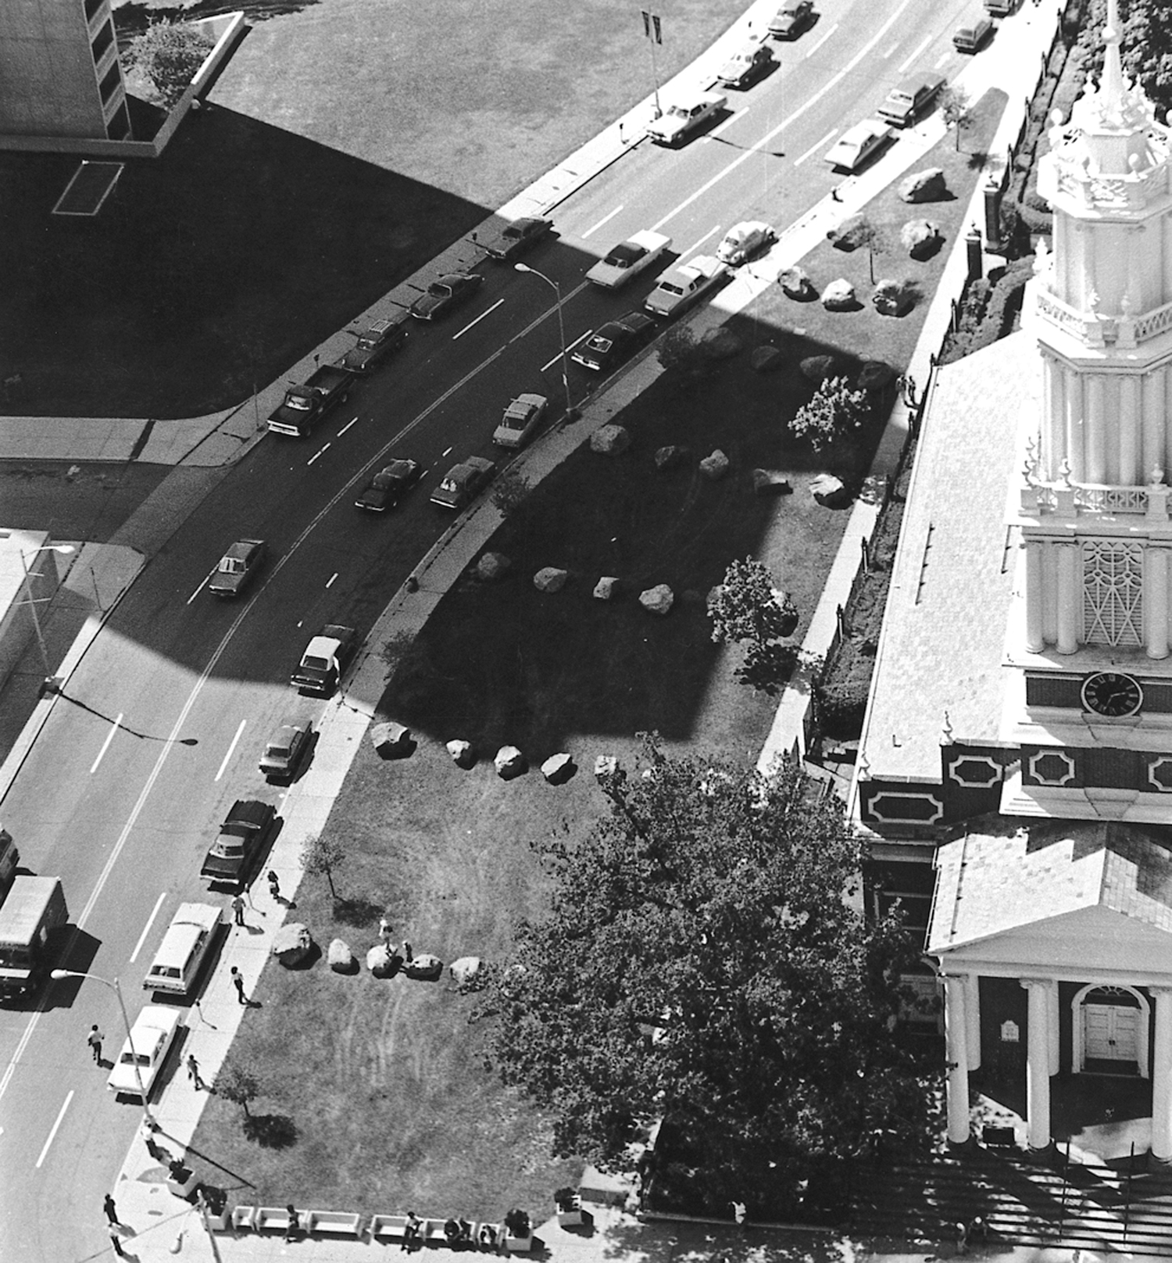

Slide 20
Title:
Artist:
Medium:
Date:

Slide 21
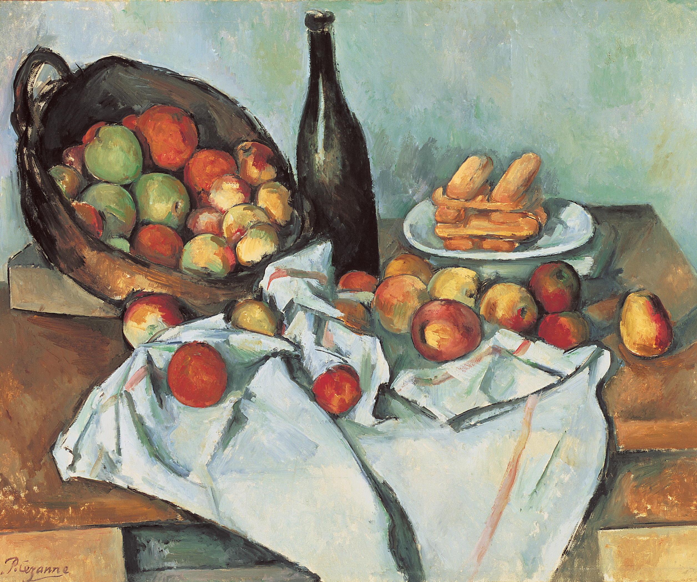

Slide 22
Title:
Artist:
Medium:
Date:

Slide 23
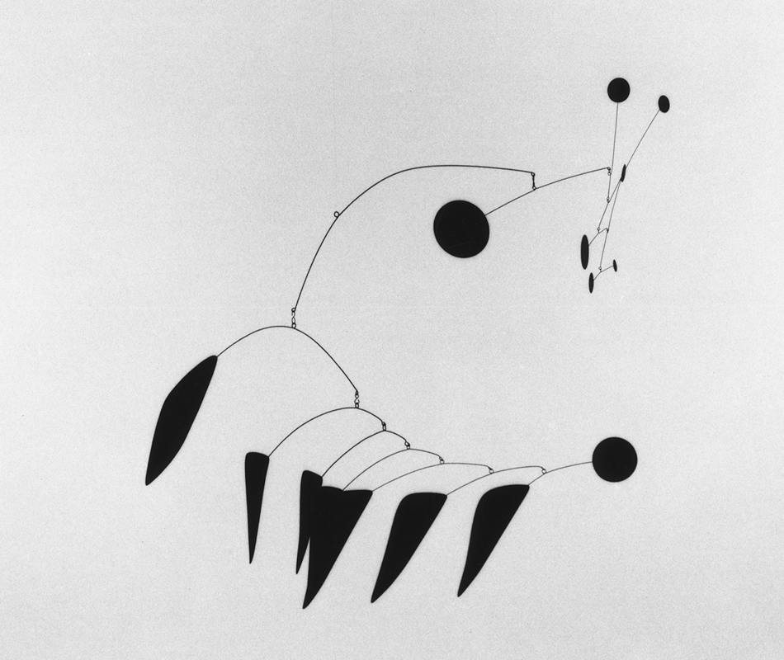

Slide 24
Title:
Artist:
Medium:
Date:

Slide 25
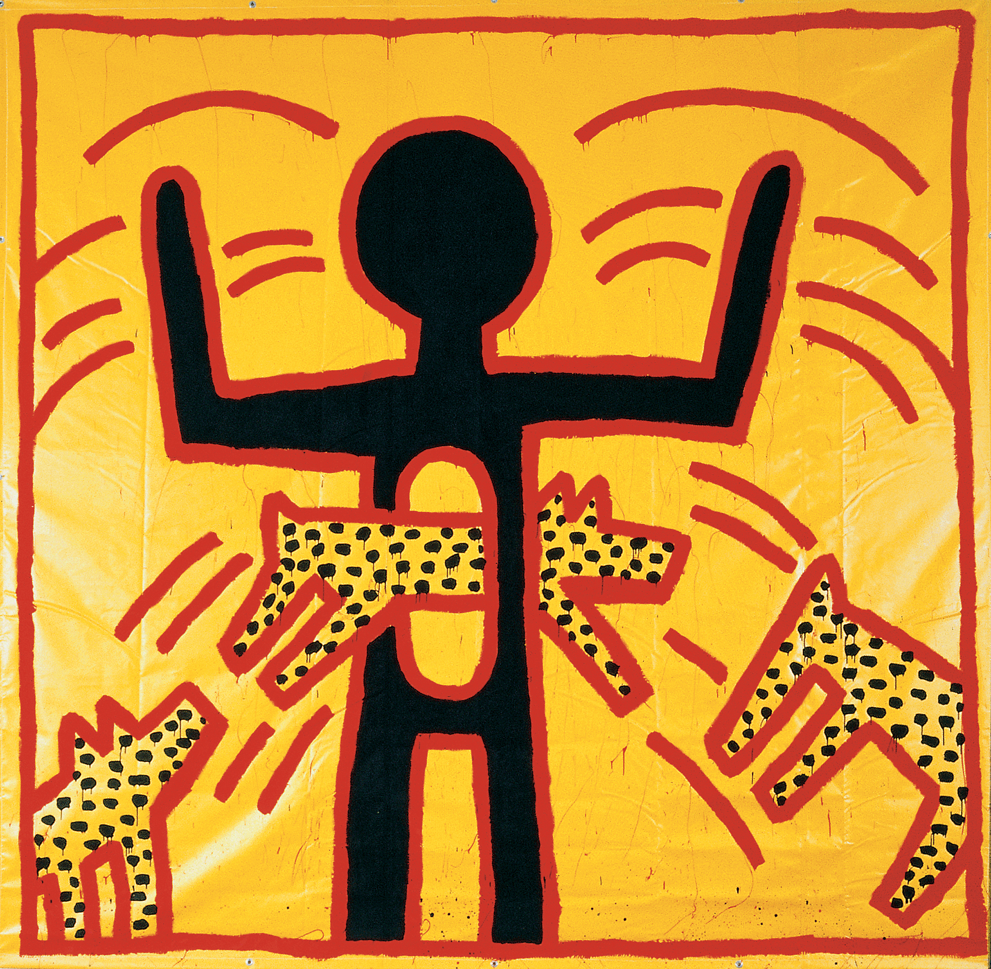

Slide 26
Title:
Artist:
Medium:
Date:

Slide 27
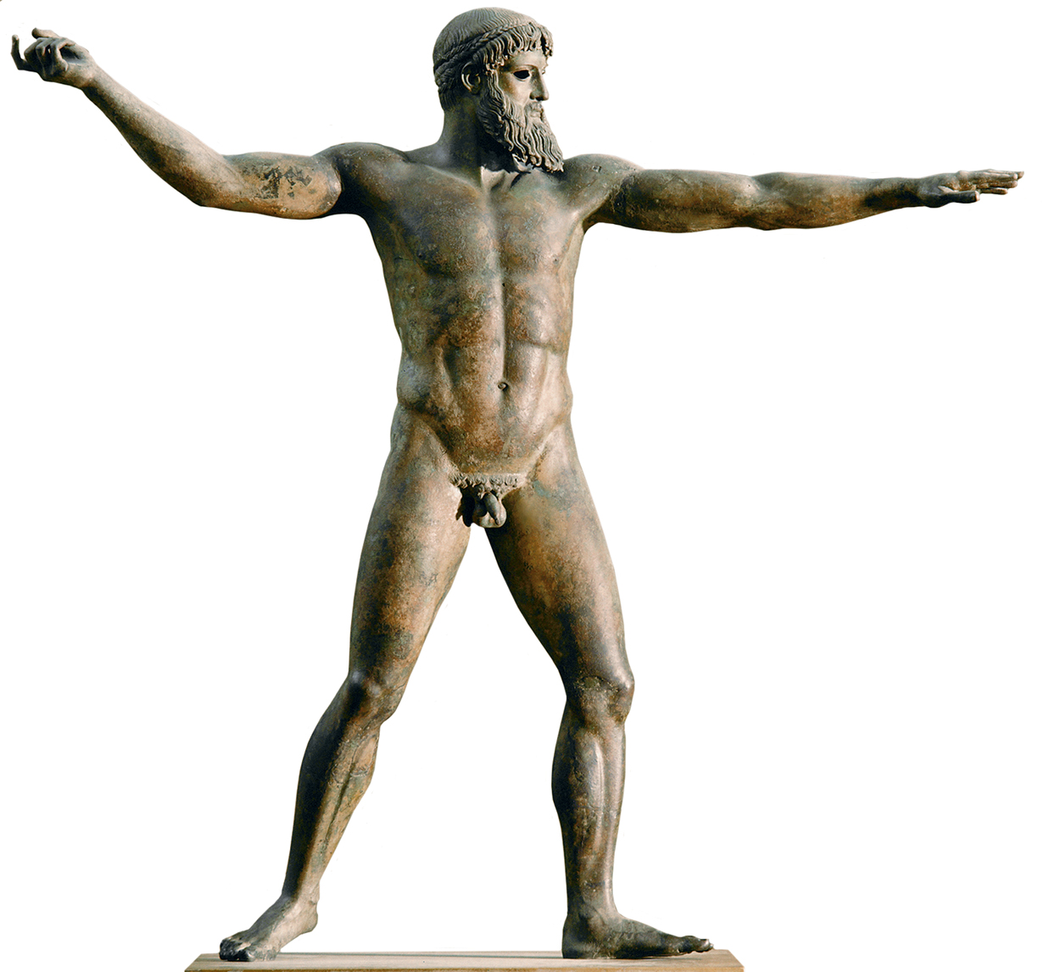

Slide 28
An example of _____________________ line,
conventionally __________________, from
________________________________

Slide 29
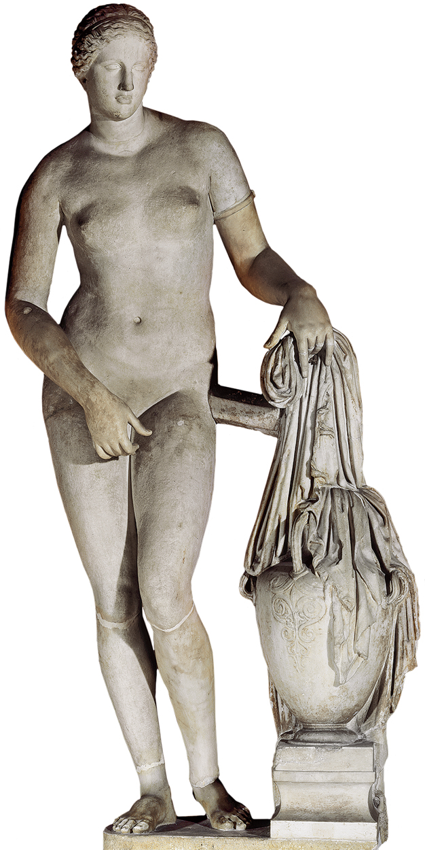

Slide 30
This one, also from ____________________
____________________________, is
considered conventionally ________________

Slide 31
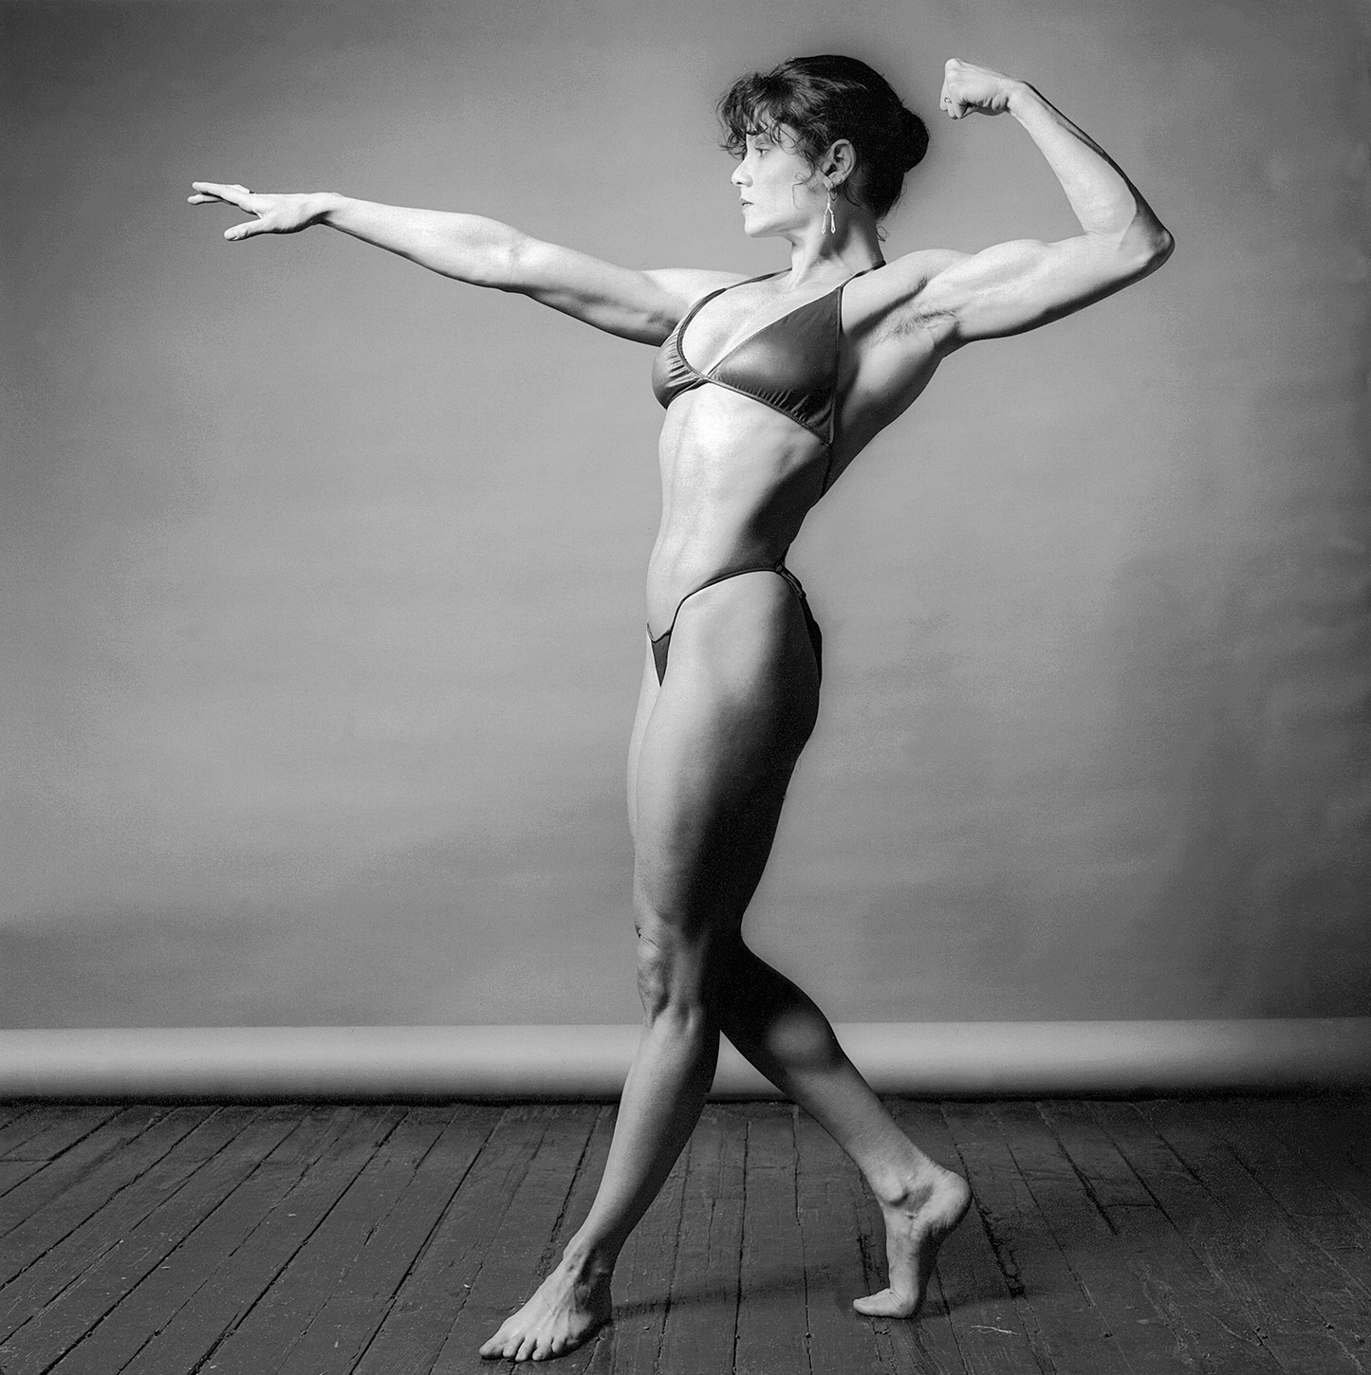

Slide 32
Update to the 19 ________; Sayre claims that
this photograph by ___________________
undermines convention by ______________
____________________________________

Slide 33
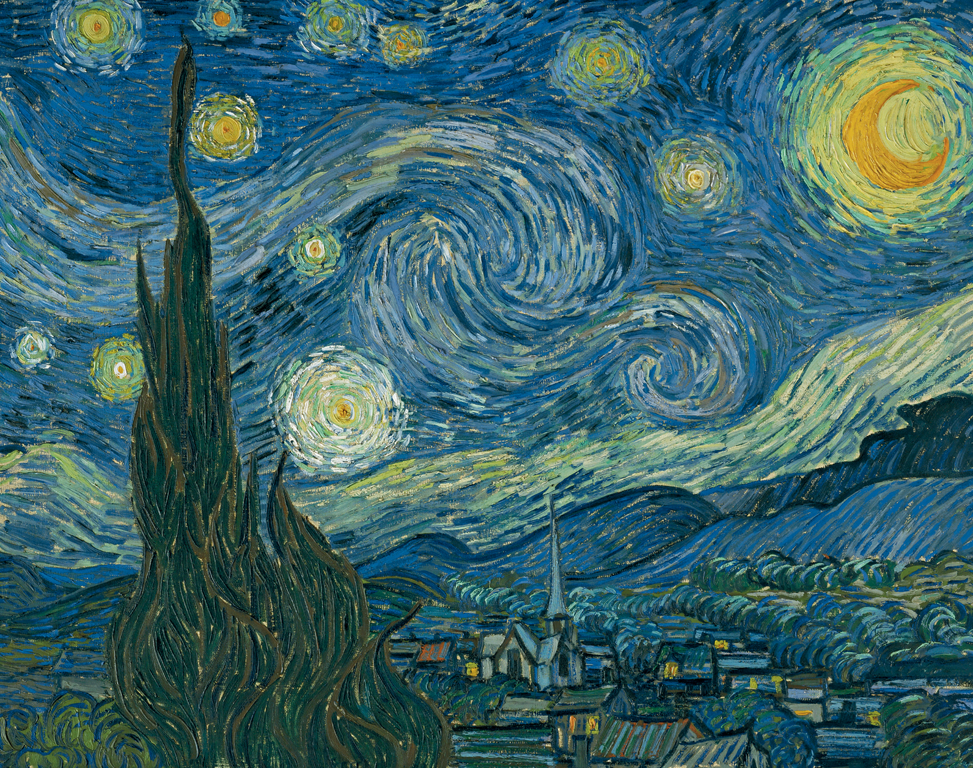

Slide 34
Painted by ___________________ in
_________________, Sayre sees this as an
example of _______________________ line.

Slide 35
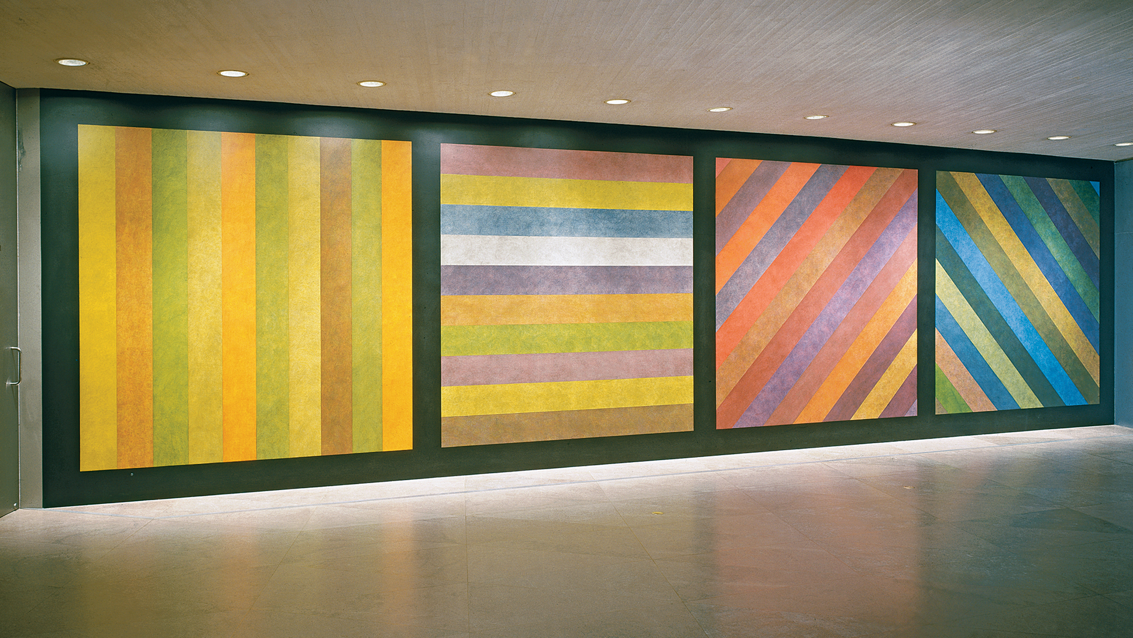

Slide 36
Created by ______________________ , this is
an example of what Sayre calls
______________________ line

Slide 37
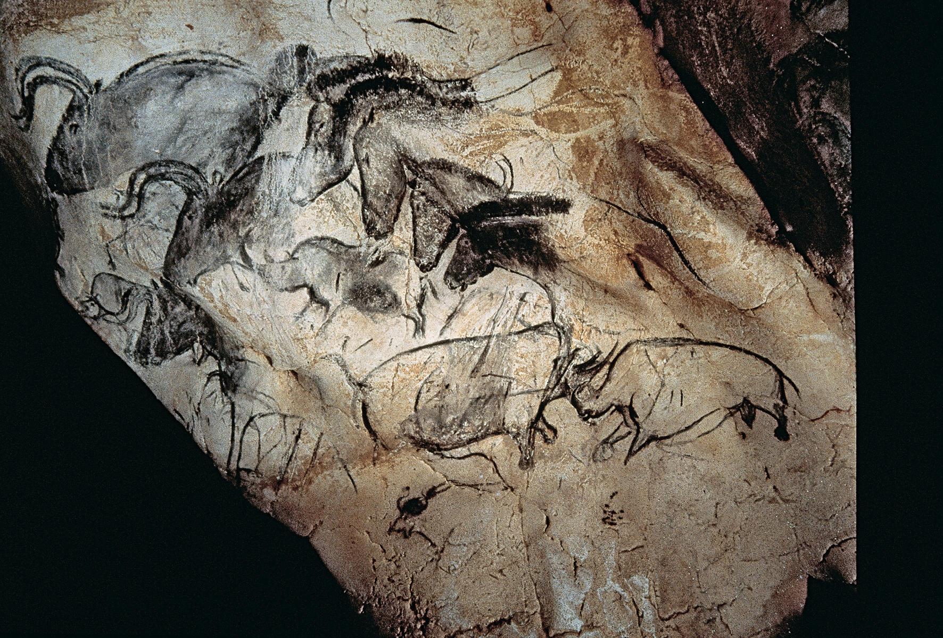

Slide 38
This image, from the painted cave at Chauvet
in southern France,dates from about
__________________ BCE.

